Slide 1

; DROP TABLE; -- Demo
Stephan Kritzinger (u24581705)
David van Rooijen (u24569039)
Caitanya Singh (u24603199)
Michael Koch (u24678300)
Dandré Nel (u24600726)
Byron Pillay (u21516261)
Graeme Geerkens (u24566285)

Slide 2
INTRODUCTION
CompareIt
A new price checking website, looking to succeed where others have failed by providing an intuitive and efficient service. Assists users with finding the best retailer to purchase a specific product.

Slide 3
Research
A price checking website should:
Compare prices of the exact same item amongst various retailers.
Allow users to leave a review of a product.
Assist the user in selecting a retailer to purchase a product from.
Have a watchlist, which allows user to monitor price changes of specific products.
Categorise and organise the products for easy access (search, filter, order, etc.)
Direct the user to the retailers’ product for easy access to purchase.

Slide 4
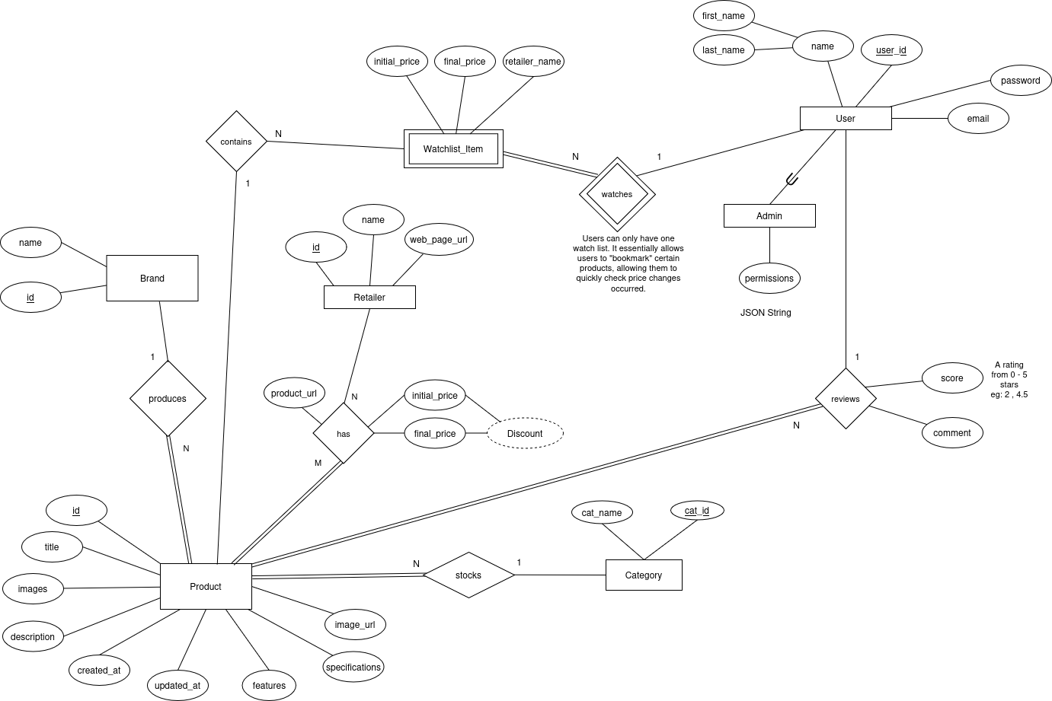
ERD Diagram

Slide 5
ERD ENTITIES
Strong entities
Weak entities
Strong Entities:
User
Retailer
Product
Category
Brand
Watchlist_Item: Relies on “watches” relationship with a User and “Contains” relationship with a Product.

Slide 6
ERD Relationships
Watches: A User watches a product for price changes. Relationship between the strong entity User and weak entity Watch_Item, with a 1:N (User : Watch_Item) cardinality and partial participation from a User. Watch_Item has total participation in this relationship.
Contains: The weak entity Watch_Item contains a Product. The cardinality is 1:N (Product : Watch_List) and both entities partially participate in the relationship.

Slide 7
ERD RELATIONSHIPS (CONTINUED)
Produces: Relationship between Brand and Product. Every product must have a brand. 1:N cardinality (Brand : Product), with total participation from Product and partial participation from Brand.
Stocks: Relationship between Category and Product. Every Product is stocked under a Category. The cardinality is 1:N (Category : Product), with partial participation from Category and total participation from Product.

Slide 8
ERD RELATIONSHIPS (CONTINUED)
Reviews: This is the relationship between a User and a product, which allows users to leave a review on a product. This relationship has the additional attributes score and comment. It’s cardinality is 1:N (User : Product), with a partial participation from a User and total participation from a Product.
Has: A retailer has a Product. This relationship contains the attributes product_url (link to the retailer’s product page), initial_price, final_price and discount which is derived from initial and final price. The cardinality is N:M, with a partial participation from Retailer and total participation from Product

Slide 9

ERD Additional Notes
Specialization : Admin is a specialization of a User and has the attribute permissions. This allows an Admin to modify the Retailer, Product and Category records.

Slide 10
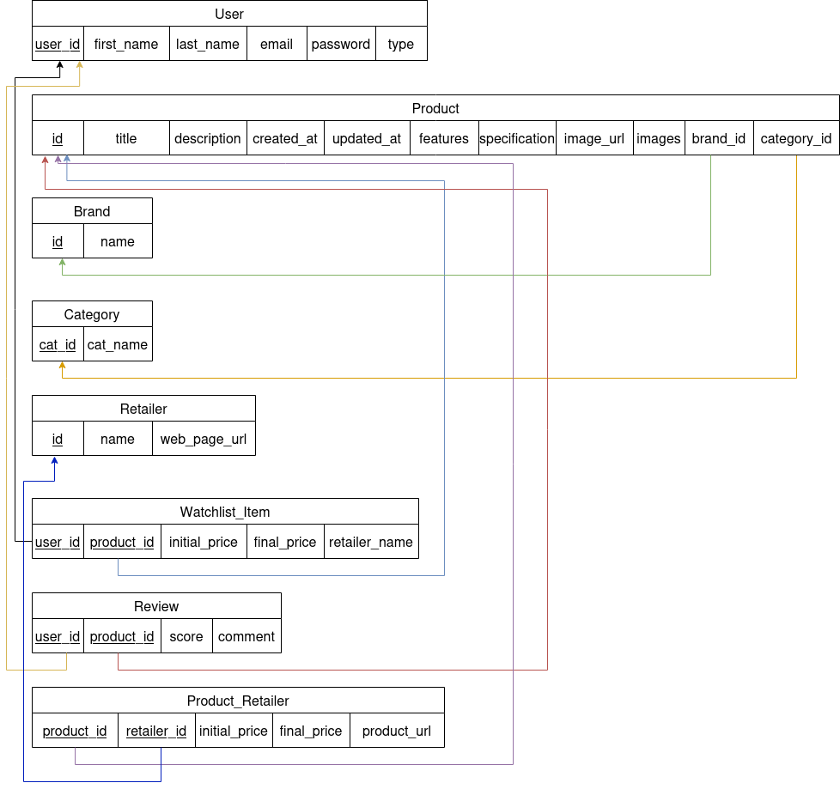
RELATIONAL MAPPING

Slide 11
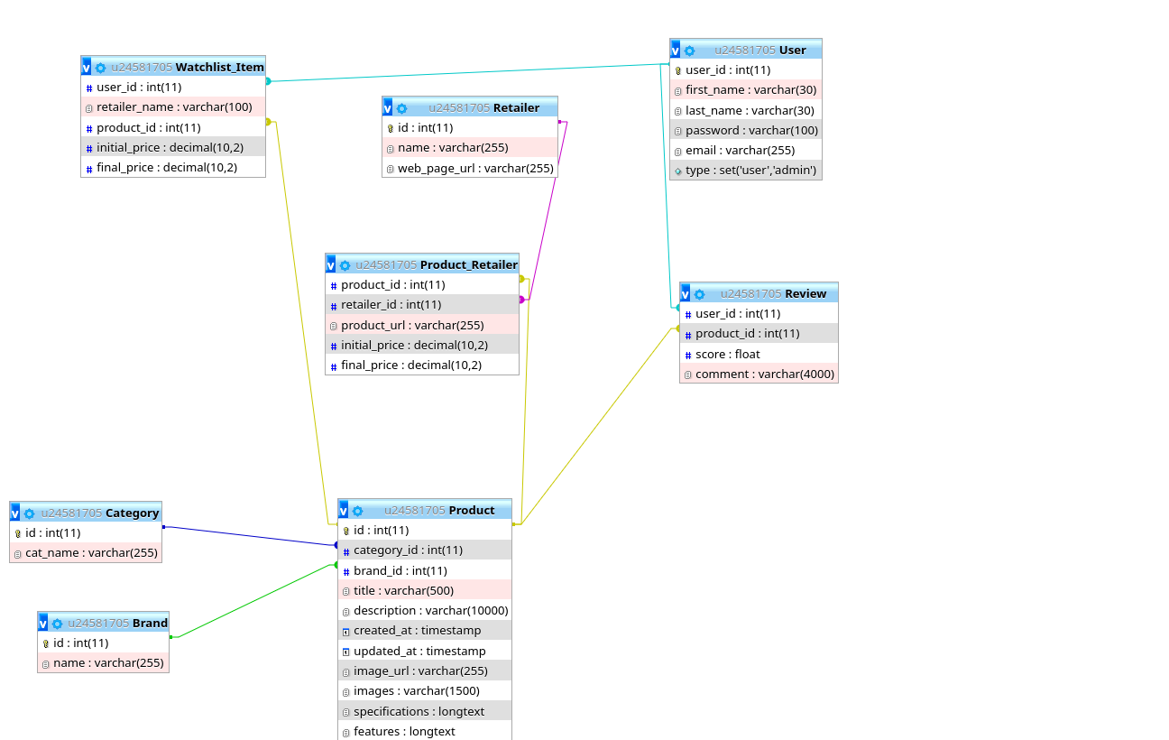

Slide 12
WEB APP FUNCTIONALITY SHOWCASE
Login/Register: Passwords are double hashed for enhanced security.
Getting products/brands/categories.
Filtering products and ordering products.
Finding all prices of a product.
Adding a review.
Adding/Updating/Removing from Watchlist
Admin specific functionality such as adding, updating or deleting a category/product/brand

Slide 13
GITHUB USAGE
Our GitHub consisted of main files (E.g. API, MAIN, JAVASCRIPT). Branches from these main files were used to compartmentalise the features added to the main files.
When a member developed a specific endpoint, they branched from the feature branch and their commits were later merged. The additional branched are deleted after merging.
All features were then merged to the main files.

Slide 14
CONTRIBUTIONS
David van Rooijen
Frontend design and implementation
Byron Pillay
Stephan Kritzinger
Michael Koch
Dandré Nel
Caitanya Singh
API endpoints
API endpoints
API documentation and requirements analysis
API documentation and requirements analysis
Research
Initial (E)ERD
JS Backend
Graeme Geerkens
Database population
API endpoints
Initial Schema
(E)ERD finalization
Everyone
PDF construction
GitHub management
PDF construction
Finalized schema
(E)ERD to Relational Mapping
PDF construction
GitHub management
JS Backend
API SQL queries

Slide 15

QUESTIONS?

Slide 16
Thank you

